Slide 1
Parse Tree Generation
Using Antlr

Slide 2
Presented By
Mohammad Mehedi Hasan
ID: 2017-1-60-085
Priyanka Mondal Piya
ID: 2017-1-60-038
Md. Jubayer Hossain Abir
ID: 2017-1-60-084

Slide 3
Overview
Introduction
Function
Parse Tree Generator
ANTLR
Features
Grammar
Input
Parsing Tree
Error
Conclusion
Wrong Input
Error Showed in CLI
Achievments

Slide 4
Parse Tree
A parse tree or parsing tree or derivation tree or concrete syntax tree is an ordered, rooted tree that represents the syntactic structure of a string according to some context-free grammar

Slide 5
ANTLR
ANTLR is a parser generator, a tool that helps us to create parsers
A parser takes a piece of text and transforms it in an organized structure, such as an Abstract Syntax Tree (AST).

Slide 6
Features
Declaration
Assignment and arithmetic operation
If-else and nested if-else
Loop and nested loop

Slide 7
Grammar
grammar comp_project;
root: header_file main_function;
header_file: '$' declaration ;
declaration: 'Easy2r8' ;
main_function: 'package_main' program;
program : '[' code ']' ;

Slide 8
Grammar Continues
code: (
statement
)+;
statement: express
|ID '=' express
|real_op
|ID inc_or_dec
|condition
|loop
;

Slide 9
Grammar Continues
express: express op=operator express
|INT
|ID
| '(' express ')'
;
real_op: express op=operator express;
loop: 'lest' '('real_op')' '['statement*']' ;
condition: 'only_if' '('real_op')' '['statement?']'
| 'otherwise' '['statement?']';

Slide 10
Grammar Continues
inc_or_dec: '++'|'--';
operator: '>'|'<'|'*'|'/'|'+'|'-'|'>='|'<=';
ID: [a-zA-Z]+ ;
INT: [0-9]+ ;
WS : [ \r\n\t]+ -> skip ;

Slide 11
Input
$ Easy2r8
package_main
[
a=(7+8)-9
only_if(a>0)
[
lest(a<=10)
[
a++
]
]
otherwise
[
a=0
]
]

Slide 12
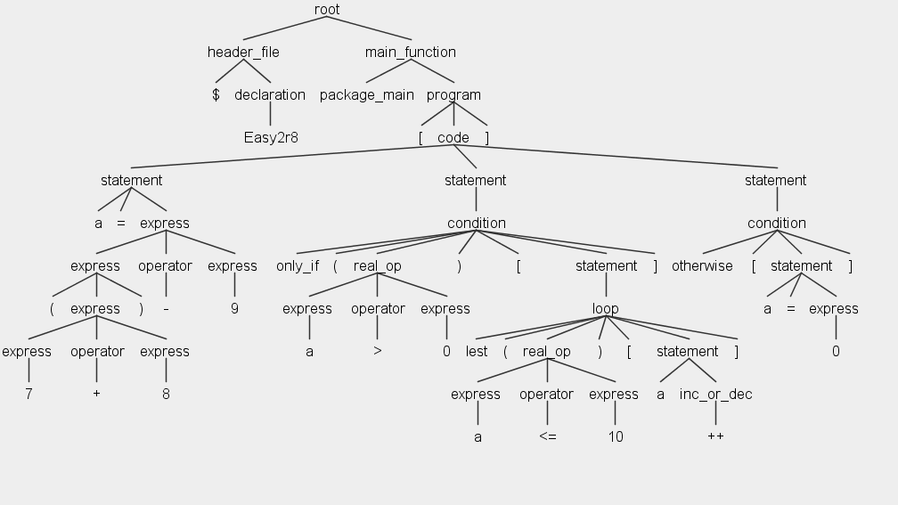
Abstract Syntax Tree (AST)

Slide 13
Wrong Input
$ Easy2r8
package_main
[
a=(7+8}-9
only_if(a>0)
[
lest(a<+10)
[
a++;
]
]
otherwise also
[
a=0;
]
]
error
error
error
error
error

Slide 14
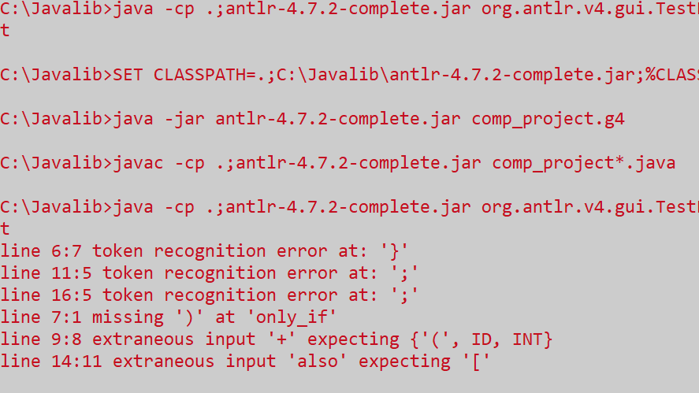
Errors showed in Command Line Interface(CLI)

Slide 15
At the End
Correctness by construction.
Better understanding of Lexical Analyzer and Regular expression.
Better understanding of Left Recursive Algorithm.
Capable of building a simple compiler.

Slide 16
Thank you!
Any questions?

